Slide 1

Voice Assistance & Navigation based Smart Shopping
GROUP MEMBERS:
Vaibhav Yadav
Devendra Khetade
Tejas Kulkarni
Aniket Kumbhar

Slide 2

Contents Introduction Literature survey Problem Statement Block Diagram Hardware & Software used Result & Discussion Conclusion Future Scope References

Slide 3

Introduction
To design Product scanning system which is based on Radio Frequency Identification.
While purchasing the products customer needs to scan the RFID tag of the product, a price of the product is taken and stored in the system’s memory.
Reduce the average time spent by the customer at the shopping mall by implementing automatic billing system using RFID technology.

Slide 4

Literature Survey

Slide 5
SR.NO | Research Paper | Publication | Review
1. | SMART-Mobile Autonomous Robotic Trolley | IEEE(2020) | In the implemented system, ATmega 16 microcontroller is interfaced with EM18 RFID reader module, buzzer and LED indicator. Wireless data transfer between the trolley billing system and billing station system is achieved through XBee ZigBee S2D. The detailed hardware-software implementation is discussed in this paper.
2. | Iot based smart shopping cart using Radio Frequency Identification | IEEE(2020) | This paper explains that the customer can easily manages the shopping list in Mobile application according to preferences. Then shopping information sends to the server wirelessly and automatically generates billing
3. | Iot based smart shopping trolley with mobile cart application | IEEE(2021) | In his paper they have used help of IoT. They have also used raspberry pi here. Along with this the customer can also log in with the mobile app which will display the list of all the products mentioned and their amount.
4. | Smart electronic trolley for shopping mall | IEEE(2018) | In this research paper it explains that Each product in the shop have an RFID tag and each trolley is equipped with a RFID reader. Payment is made by the customer card. The smart trolley system is very efficient for both customers as well as the shop owners.

Slide 6
SR.NO | Research Paper | Publication | Review
5. | Smart shopping using smart trolley | IEEE(2018) | In this paper it is proposed to design a smart trolley which can take care of shopping and billing. They have used Arduino board, Radio-Frequency Identification (RFID) reader, RFID tag, LCD display, ESP8266 Wi-Fi module, database manager and a website to maintain product and customer details, which can be accessed by the admin anywhere in the world. This is an IOT based system where the trolley can interact with the network spread worldwide.
6. | Human friendly smart trolly with automatic billing system | IEEE(2020) | Very advanced as compare to normal shopping system as this revolutionizes by using RFID system and hence time saving
7. | Smart trolley | IEEE(2021) | This paper help all the people those goes for shopping and face problems of standing in long line at the shopping complex counter which is a total wastage of time for them.
8. | Automated billing smart trolley | IEEE(2021) | This is designed in such a way that the data of the customer is sent to the counter through wifi module which reduce standing in long queue

Slide 7

Problem Statement
The problem we are facing in today’s shopping malls are:
Long waiting time for billing process as the customer has to place all the items at the counter for scanning. This makes the checkout process very slow
Involvement of a lot of labor for scanning and billing process.

Slide 8
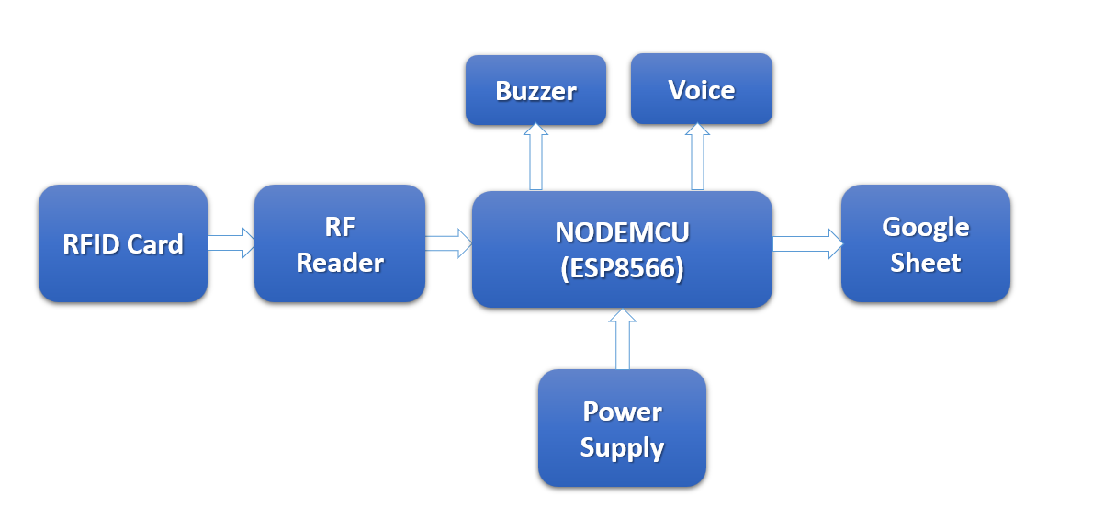
Block Diagram

Slide 9

Block Description
A data is stored in RFID card and is scanned through RF reader.
NodeMCU (ESP8266) is connected to RF reader where a programming is done to write and read data.
A Buzzer is there which beeps that indicates a card is scanned.
A Google sheet is allocated to store all data which is scanned and that is connected to NodeMCU through Internet.
As soon as you scan a card, you will hear beep sound & at the same time you will hear the audio of the data.
The same data you will be stored in google sheet & it will be visible on website.

Slide 10
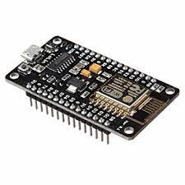
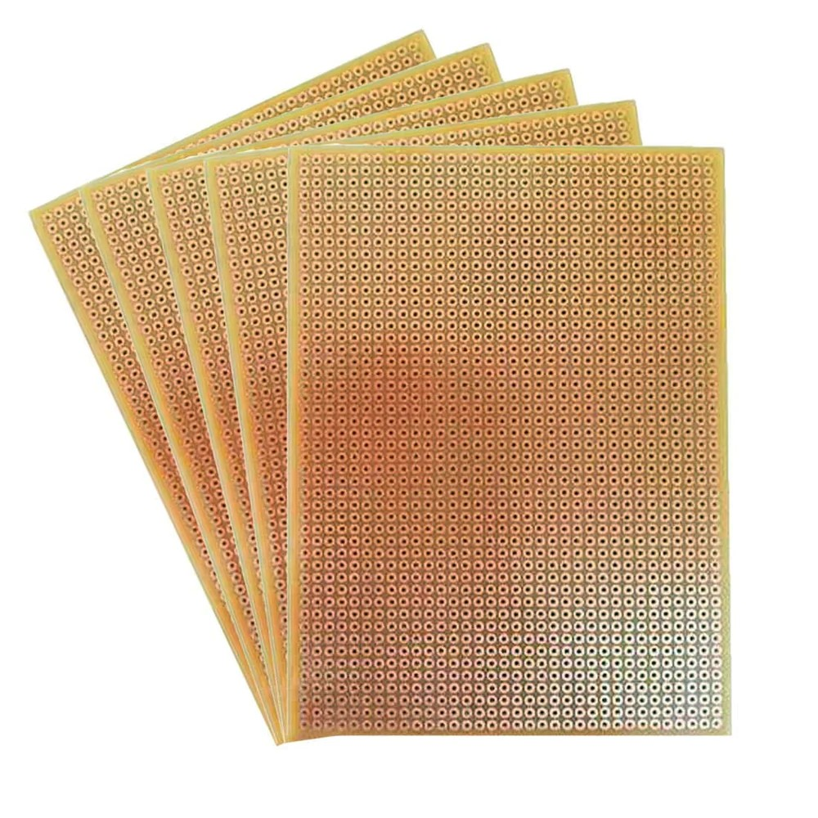
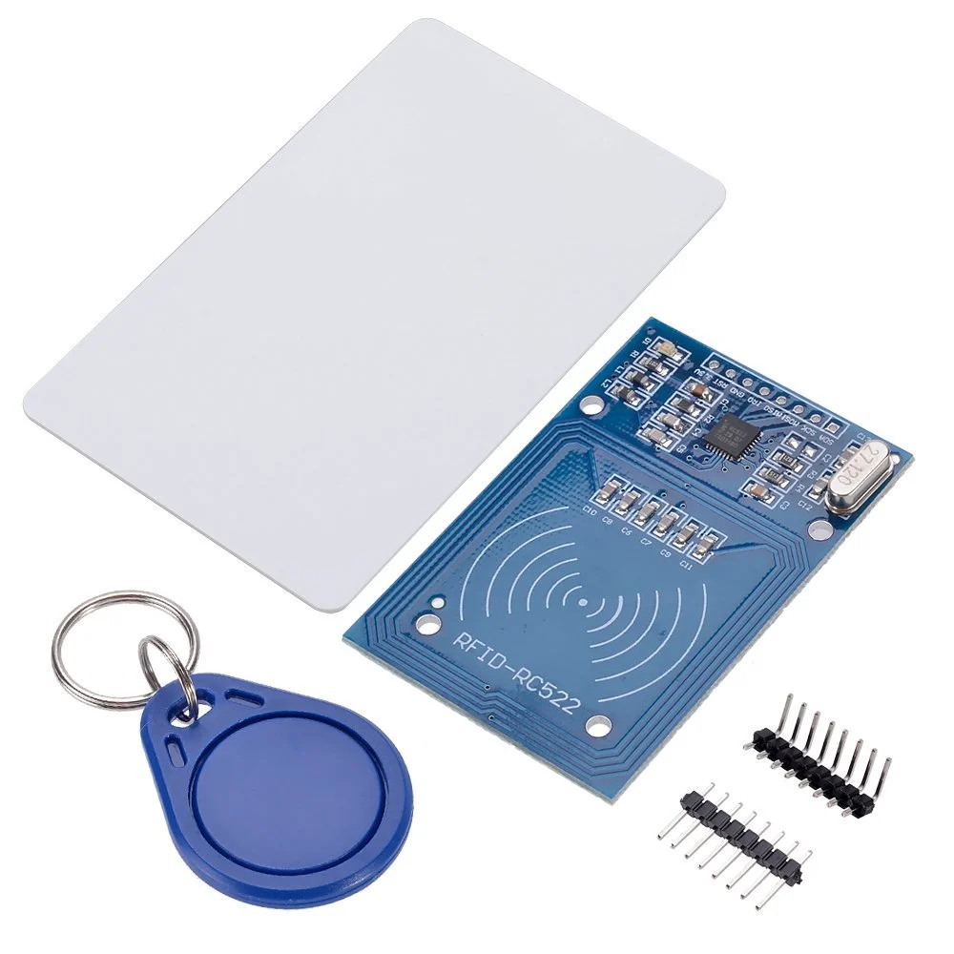
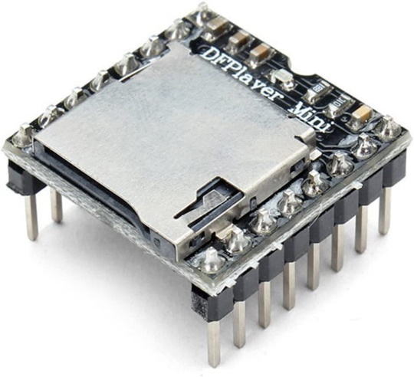
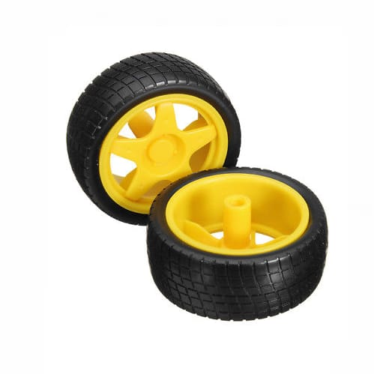
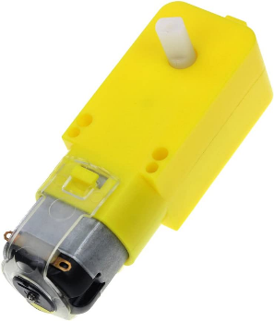
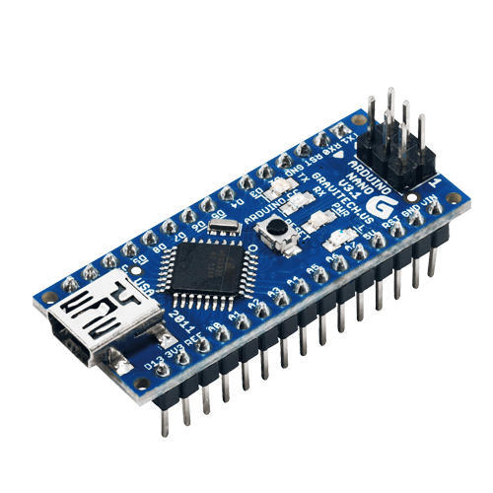
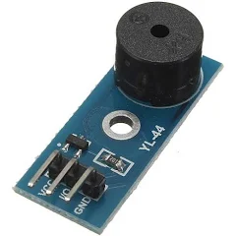
Hardware
RFID
NodeMCU
Zero PCB
DF Mini Player
BO Wheels
Buzzer
Bo Motor
Arduino Nano

Slide 11



Software
Arduino IDE
WordPress
XAMPP Server

Slide 12
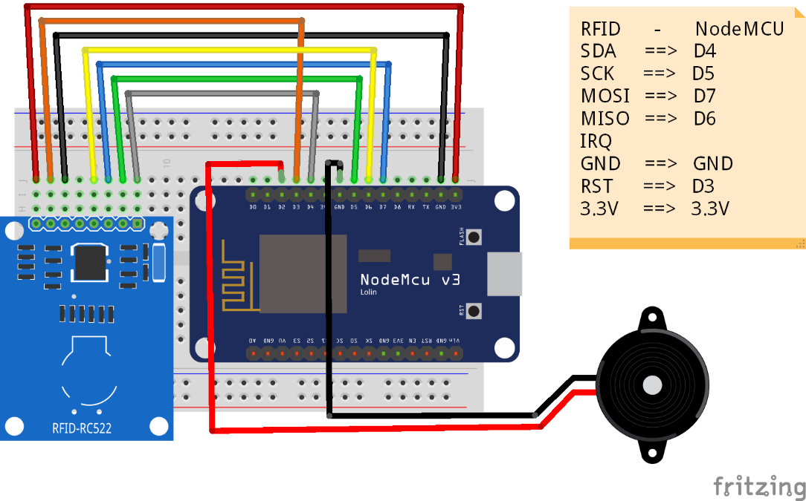
System Diagram
RFID Reader with NODEMCU

Slide 13
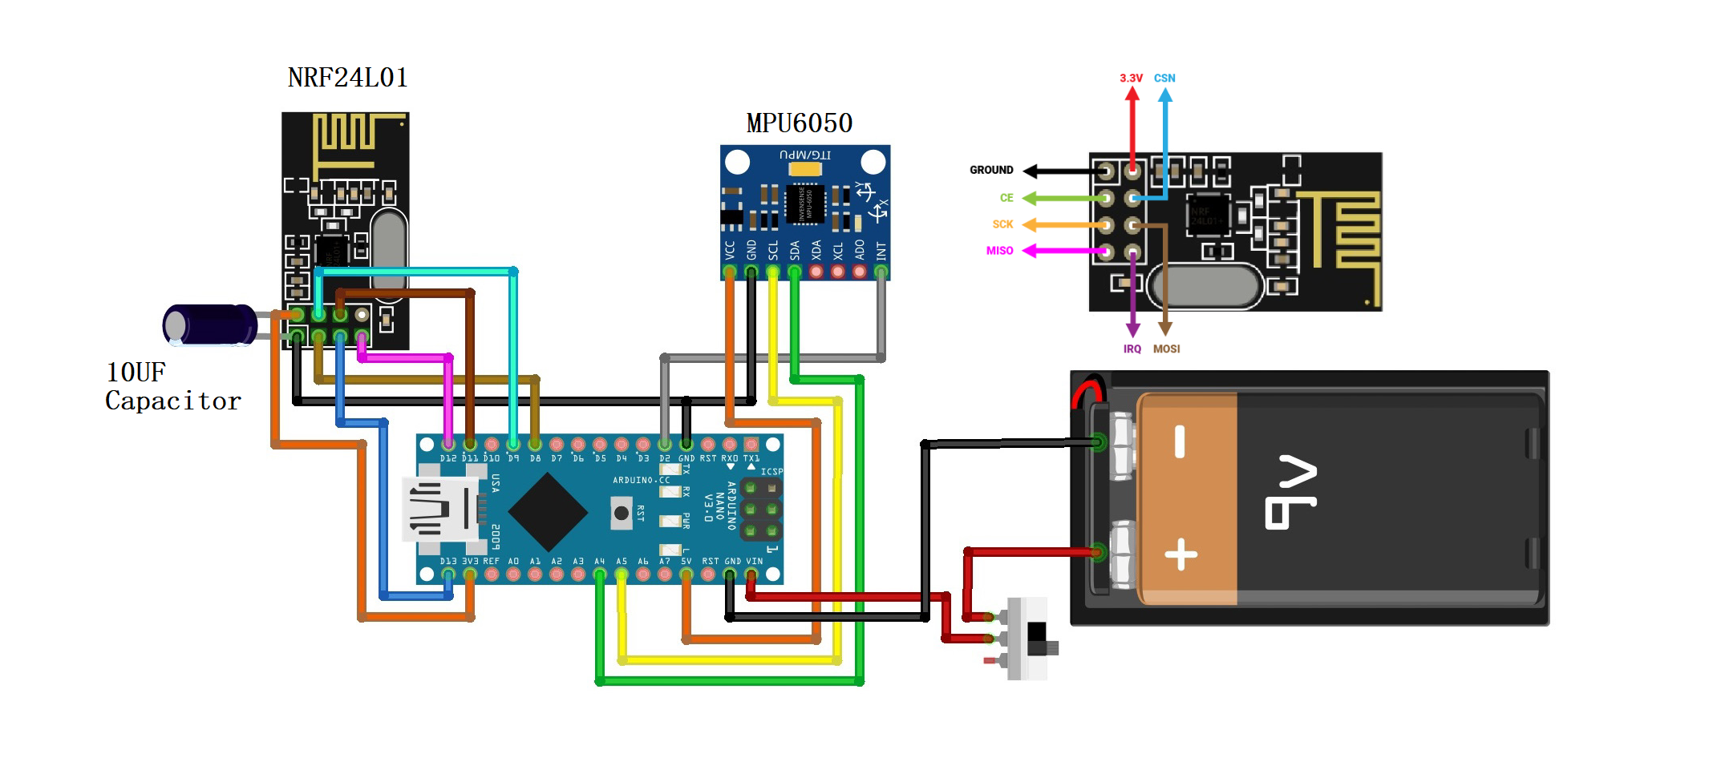
Circuit Diagram
Transmitter Circuit for Trolley

Slide 14
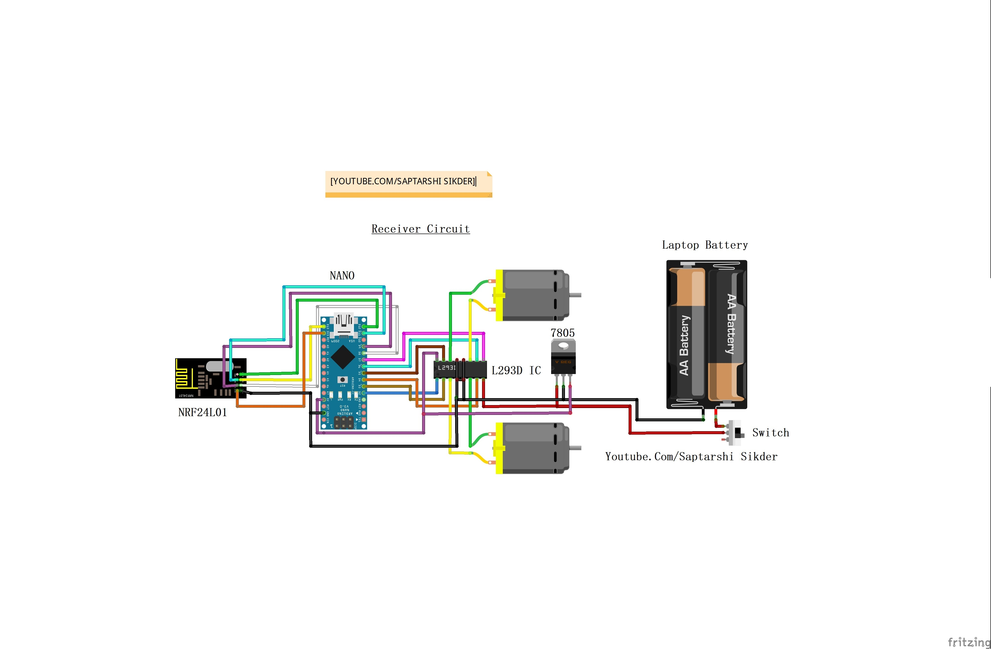
Receiver Circuit for Trolley

Slide 15
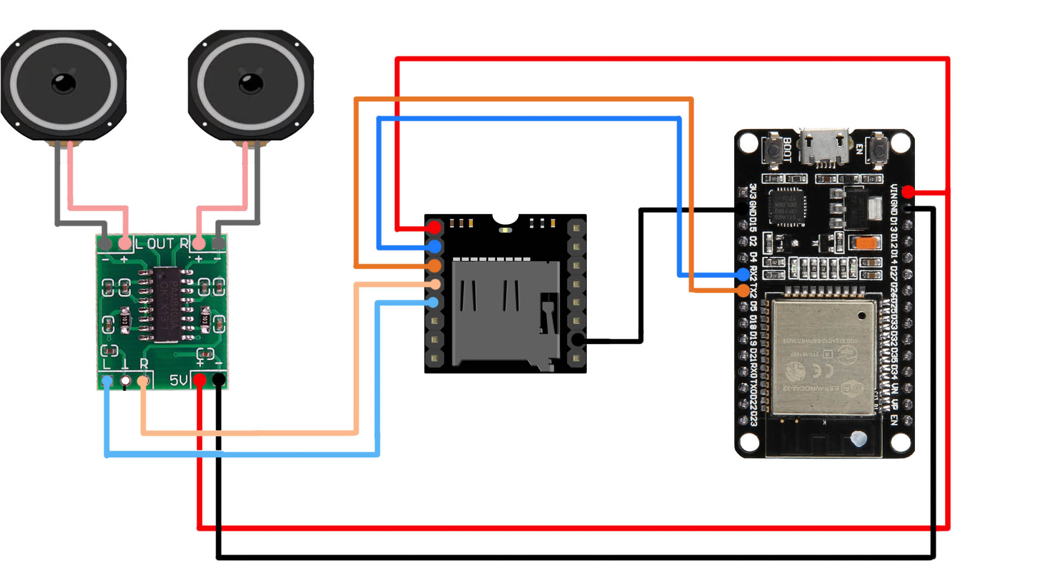
Audio circuit Diagram with NODEMCU

Slide 16

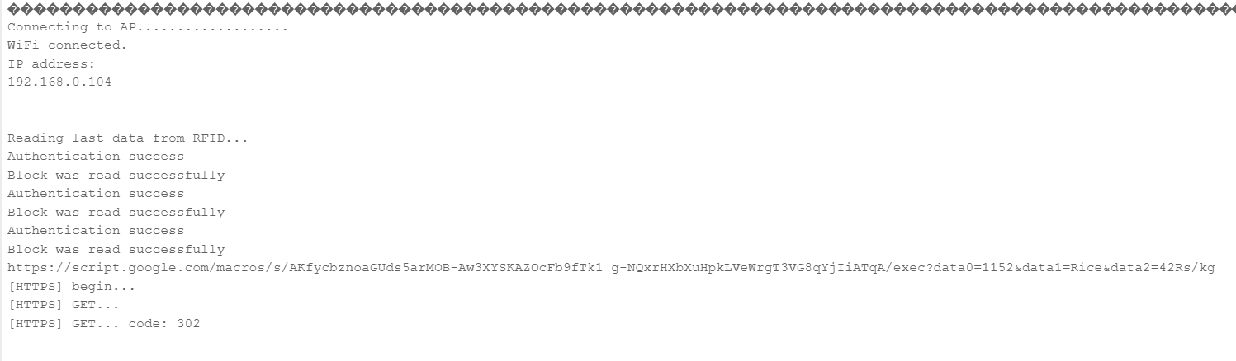
Result
1.When you scan a card the given below message will show in Arduino IDE Serial monitor

Slide 17
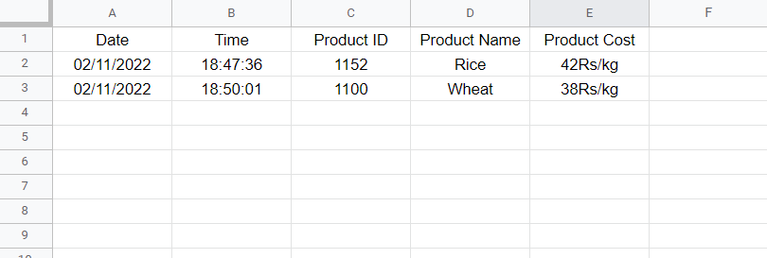
2. When RFID has scanned a data will store in google sheet as shown below

Slide 18
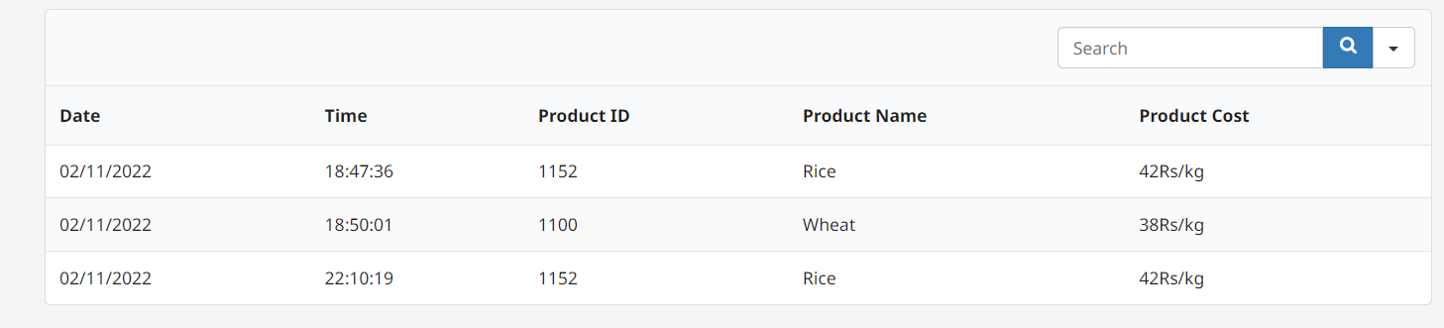
3.The scanned data stored in Google sheet the same data you will also see on website

Slide 22
Conclusion
We have seen the working of the entire smart trolley system & can understand from the set up that it is very user friendly. The voice assistance along with the item scanner gives proves to be very beneficial. For further assistance we can also look upto the navigation guide provided on the screen. The system integrates the trolley and your device seamlessly to your advantage saving a lot of time. It can be improved to new levels in future with more resources and time.

Slide 23
Future Scope
Development of project can be done in many ways, where RFID tags can be replaced by NFC tags which are small in size, low cost.
Security can be improved by counting the number of items or placing weight sensors within the cart for tallying the weight and getting all the types of product names when cart is passed through a particular aisle using camera module. This will prevent theft of any item from the shop & can also be trackable.
Also, with the help of optical sensor, motors, and motor drivers, we will make trolley in such a way that it will follow the customer which purchasing items and it maintains the safe distance between customer and itself.

Slide 24
References
For Scanning Product & updating product data on google sheet online we had referred this Video : https://youtu.be/Bgs_3F5rL5Q
For making website we had referred this video : https://youtu.be/GlLRYml8mCY
Prof.Tapan Kumar Das, Prof. Asis Kumar Tripathy, Prof. Kathiravan Srinivasan, A Smart Trolley for Smart Shopping, IEEE 2020, ISBN 978-1-7281-6202-7.

Slide 25
Thank You

